Slide 1
Measurement and Digital Twin
Jan 2024

Slide 2

Digital Twin: Discussion
Examples
Physical twin
Virtual twin

Slide 3
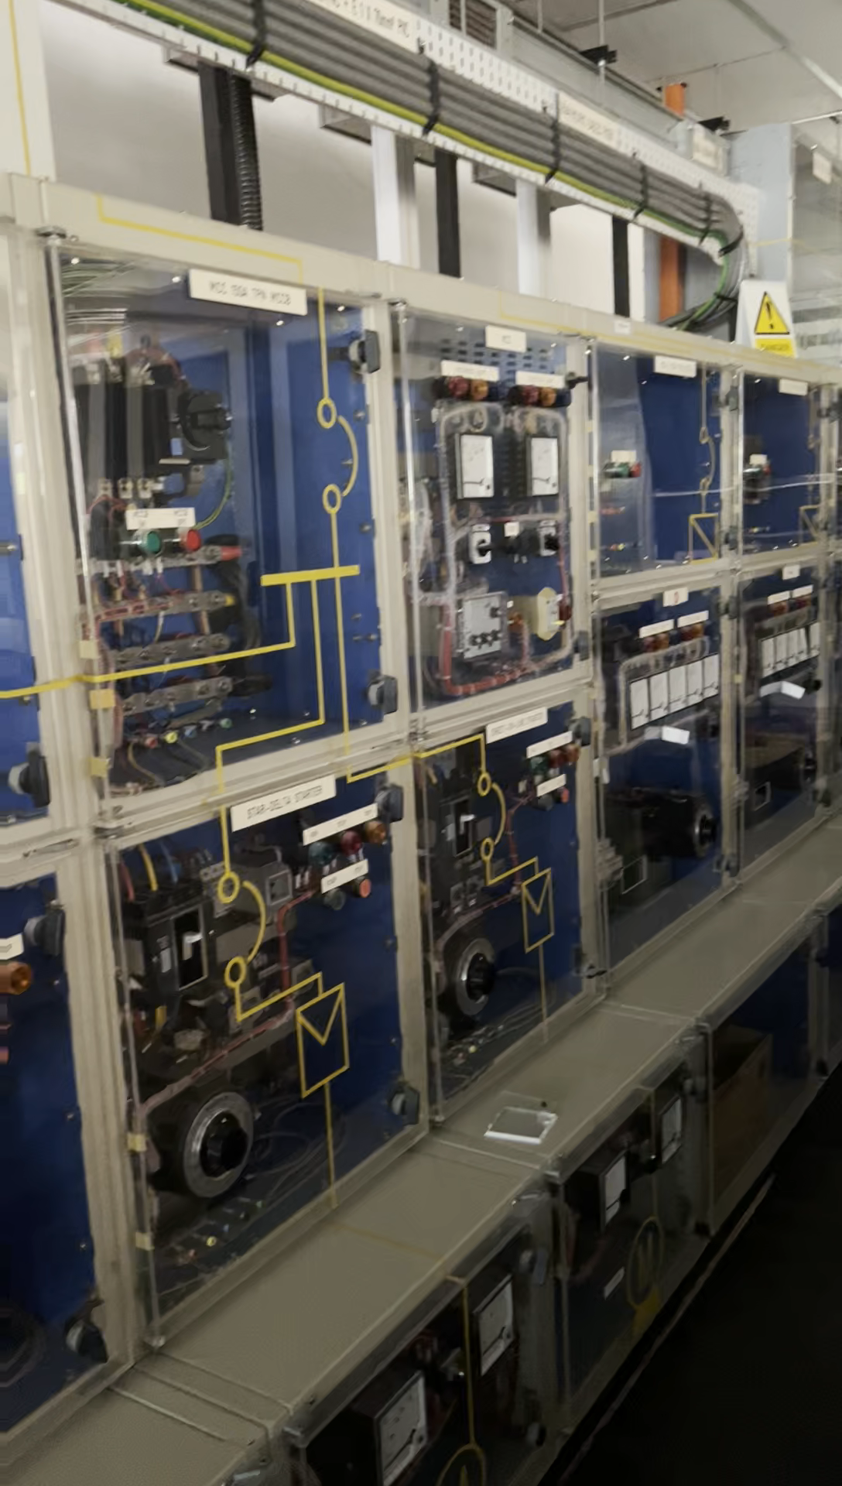
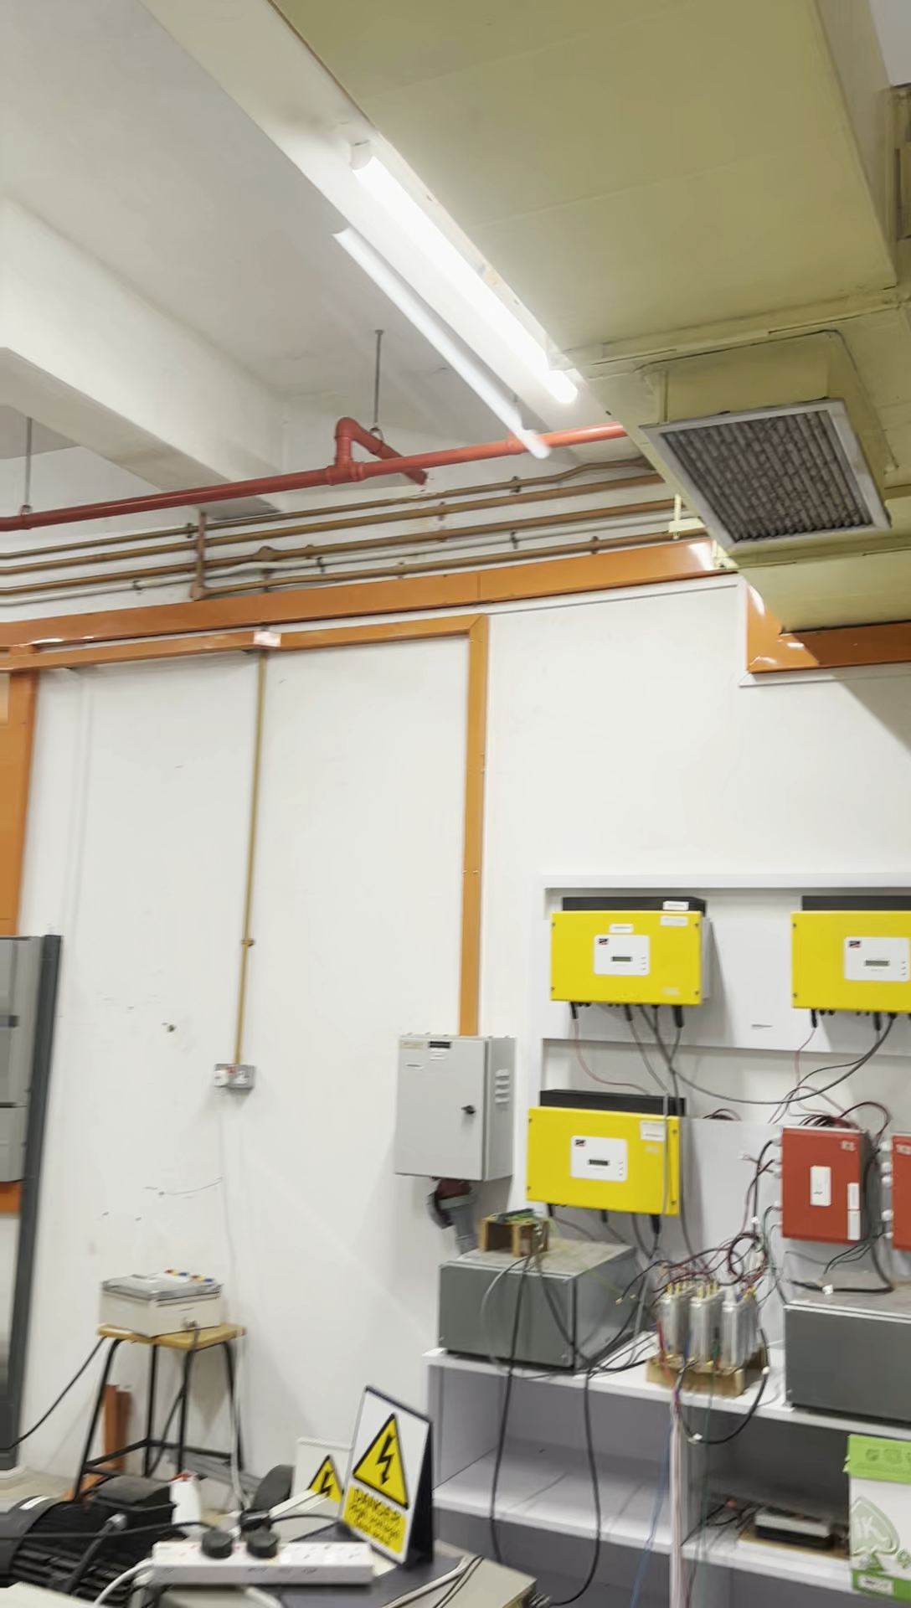
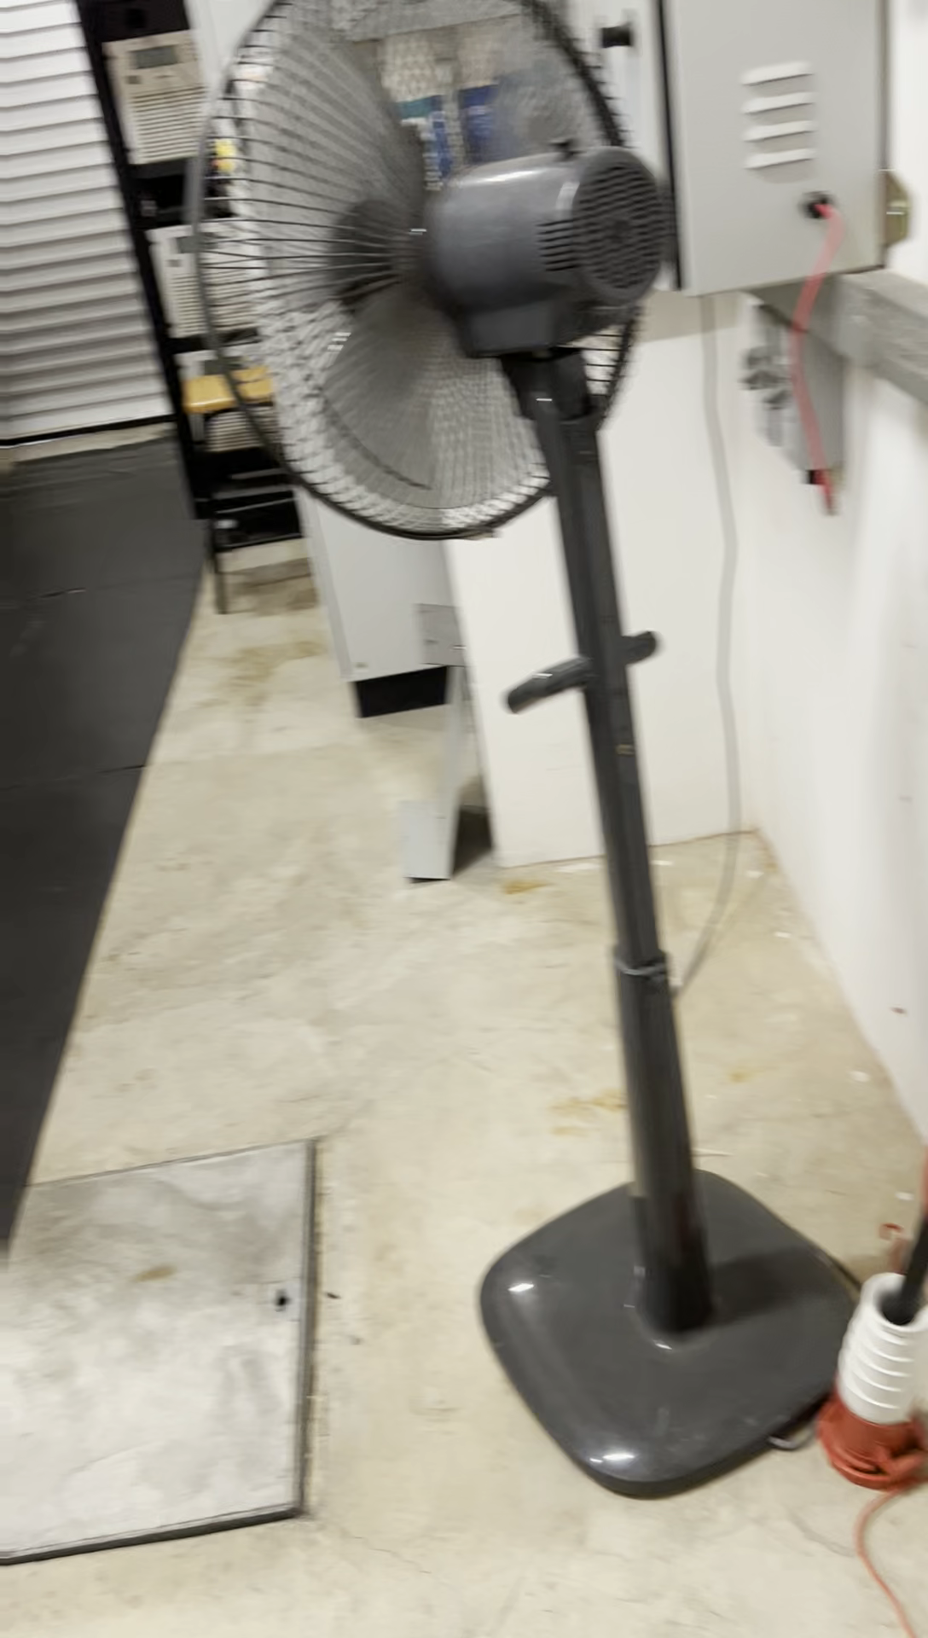
Digital Twin: Micro Grid

Slide 4
Digital Twin: The Six M Method
Physical twin
Virtual twin
Manpower, Machine, Material, Medium (Milieu), Method, Measurement

Slide 5
Digital Twin: The Six M Method
Physical twin
Virtual twin
Manpower, Machine, Material, Medium (Milieu), Method, Measurement

Slide 6
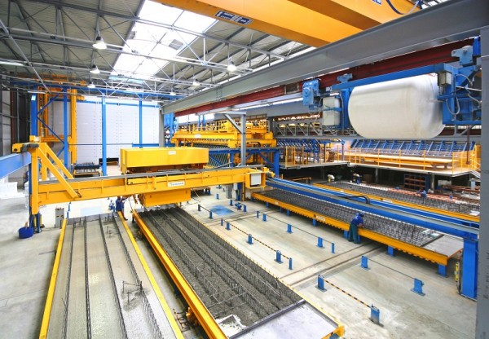
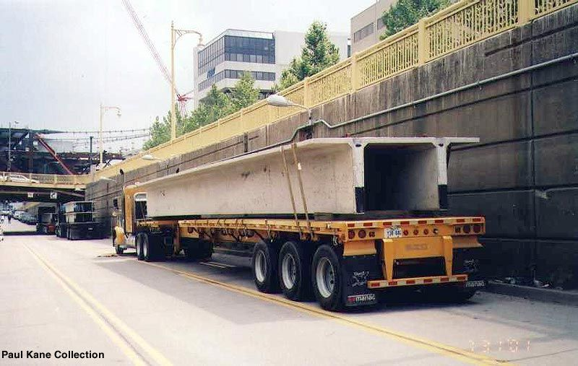
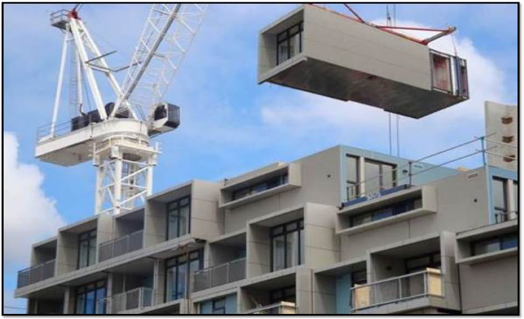
Digital Twin: Building Information Model
Physical World vs Virtual World
Production
Logistics
Construction
Maintenance
Precast factory
Road & Truck
Construction site
Building

Slide 7
Digital Twin: Mechatronics & Measurement
Manpower
Physical twin
Method
Virtual twin
Measurement
Two Way Way Communication
Machine
Material
Medium

Slide 8
Measurement
Sensor
IoT
Digital Twin

